Slide 1

Chapter 11
Data Link Control
11.<number>
Copyright © The McGraw-Hill Companies, Inc. Permission required for reproduction or display.

Slide 2
11-1 FRAMING
The data link layer needs to pack bits into frames, so that each frame is distinguishable from another. Our postal system practices a type of framing. The simple act of inserting a letter into an envelope separates one piece of information from another; the envelope serves as the delimiter.
Topics discussed in this section:
Fixed-Size Framing
Variable-Size Framing
11.<number>

Slide 3
OSI data link layer
OSI model layer 2
TCP/IP model part of Network Access layer
Application
HTTP, FTP, TFTP, SMTP etc
Presentation
Data stream
Application
Session
Transport
Segment
TCP, UDP
Transport
Network
Packet
IP
Internet
Data link
Frame
Ethernet, WAN technologies
Network Access
Physical
Bits

Slide 4

Data Link Layer Functions
Framing

Slide 5
Hops
There may be a different layer 2 protocol in use on each hop of a journey.
Different media, different types of link, different bandwidths, LAN/WAN affect the choice of protocol.
Different protocols have different frames.
The router removes the old frame and adds a new header and trailer for the next hop.

Slide 6
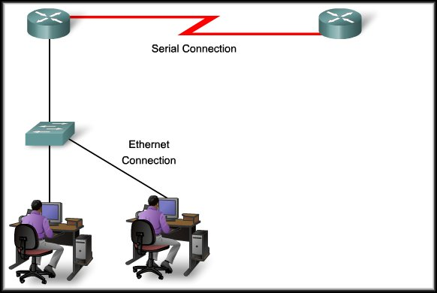
Controlling Transfer Across Local Media
WAN Header
WAN Trailer
LAN Header
LAN Header
Packet
Packet
LAN Trailer
LAN Trailer
Different media…
Different characteristics…
Different MAC method…

Slide 7
The Frame
However, each Data Link Layer protocol is constructed using the same basic format.
  It’s the contents that differ….
Header | Data | Trailer
Role of the Header
        Contains the control information required by the protocol.

Slide 8
Framing: Role of the Header
Specific bit sequence that indicates to the receiving device that the frame starts here.
For example:
Header |  |  | Data | Trailer
Start | Address | Type/Length
The source and destination MAC addresses.
A code identifying the type of frame OR
the total length of the frame.

Slide 9
Frames
Flags and Byte/Bit Stuffing

Slide 10

A frame in a character-oriented protocol

Slide 11

Byte stuffing
Note
Byte stuffing is the process of adding 1 extra byte whenever there is a flag or escape character in the text.

Slide 12

Byte stuffing and unstuffing

Slide 13

A frame in a bit-oriented protocol

Slide 14
Bit stuffing
Note
Bit stuffing is the process of adding one extra 0 whenever five consecutive 1s follow a 0 in the data, so that the receiver does not mistake
the pattern 0111110 for a flag.

Slide 15

Bit stuffing and unstuffing

Slide 16
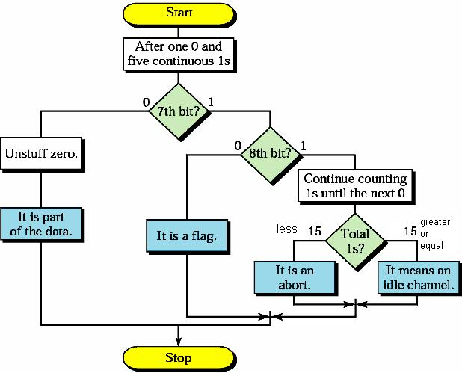
Flow Diagram- Receiver Side

Slide 17
Three exceptions
With 3 exceptions bit stuffing is required whenever five 1s occur consecutively:
  Bit sequence really is a flag
  The transmission is being aborted
  The channel is being put into idle

Slide 18
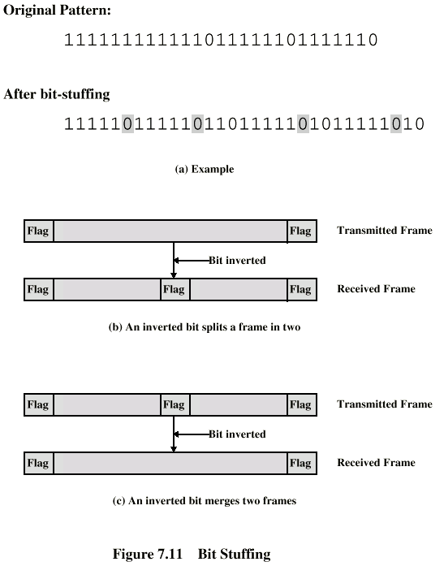
Bit Stuffing
Example with
possible errors

Slide 19
11-2 FLOW AND ERROR CONTROL
The most important responsibilities of the data link layer are flow control and error control. Collectively, these functions are known as data link control.
Topics discussed in this section:
Flow Control
Error Control
11.<number>

Slide 20
Flow Control
Begin
Stop
No
More data
to Tx?
Rcv Data from Tx
Yes
Clear Buffer
Is there buffer
capacity left?
No
Stop Rcv’ng Data
from Tx
Yes
Process Data
Transfer Data
to next upper layer

Slide 21
Note
Flow control refers to a set of procedures used to restrict the amount of data
that the sender can send before
waiting for acknowledgment.
11.<number>

Slide 22
Note
Error control in the data link layer is based on automatic repeat request, which is the retransmission of data.
11.<number>

Slide 23
11-3 PROTOCOLS
Now let us see how the data link layer can combine framing, flow control, and error control to achieve the delivery of data from one node to another. The protocols are normally implemented in software by using one of the common programming languages. To make our discussions language-free, we have written in pseudocode a version of each protocol that concentrates mostly on the procedure instead of delving into the details of language rules.
11.<number>

Slide 24

Figure 11.5 Taxonomy of protocols discussed in this chapter
11.<number>

Slide 25
11-4 NOISELESS CHANNELS
Let us first assume we have an ideal channel in which no frames are lost, duplicated, or corrupted. We introduce two protocols for this type of channel.
Topics discussed in this section:
Simplest Protocol
Stop-and-Wait Protocol
11.<number>

Slide 26

Figure 11.6 The design of the simplest protocol with no flow or error control
11.<number>

Slide 27
Example 11.1
Figure 11.7 shows an example of communication using this protocol. It is very simple. The sender sends a sequence of frames without even thinking about the receiver. To send three frames, three events occur at the sender site and three events at the receiver site. Note that the data frames are shown by tilted boxes; the height of the box defines the transmission time difference between
the first bit and the last bit in the frame.
11.<number>

Slide 28

Figure 11.7 Flow diagram for Example 11.1
11.<number>

Slide 29

Figure 11.8 Design of Stop-and-Wait Protocol
11.<number>

Slide 30
Example 11.2
Figure 11.9 shows an example of communication using this protocol. It is still very simple. The sender sends one frame and waits for feedback from the receiver. When the ACK arrives, the sender sends the next frame. Note that sending two frames in the protocol involves the sender in four events and the receiver in two events.
11.<number>

Slide 31

Figure 11.9 Flow diagram for Example 11.2
11.<number>

Slide 32
11-5 NOISY CHANNELS
Although the Stop-and-Wait Protocol gives us an idea of how to add flow control to its predecessor, noiseless channels are nonexistent. We discuss three protocols in this section that use error control.
Topics discussed in this section:
Stop-and-Wait Automatic Repeat Request
Go-Back-N Automatic Repeat Request
Selective Repeat Automatic Repeat Request
11.<number>

Slide 33
Stop-and-Wait Flow Control
How does it work?
  Source transmits frame
  Destination receives frame and replies with acknowledgement
  Source waits for ACK before sending next frame
  Destination can stop flow by not sending ACK
Works well for a few large frames
Not good when fragmentation is used
Notes:
Fragmentation → Large block of data may be split into smaller frames
Used when:
Limited buffer size
Errors detected sooner (when whole frame received)
On error, retransmission of smaller frames is needed
Prevents one station occupying medium for long periods

Slide 34
Fragmentation
Large block of data may be split into small frames
  Limited buffer size
  Errors detected sooner (when whole frame received)
  On error, retransmission of smaller frames is needed
  Prevents one station occupying medium for long periods
Stop and wait becomes inadequate

Slide 35

Figure 11.10 Design of the Stop-and-Wait ARQ Protocol
11.<number>

Slide 36
Note
Error correction in Stop-and-Wait ARQ is done by keeping a copy of the sent frame and retransmitting of the frame when the timer expires.
11.<number>

Slide 37
Note
In Stop-and-Wait ARQ, we use sequence numbers to number the frames.
The sequence numbers are based on modulo-2 arithmetic.
11.<number>

Slide 38
Note
In Stop-and-Wait ARQ, the acknowledgment number always announces in modulo-2 arithmetic the sequence number of the next frame expected.
11.<number>

Slide 39
Stop-And-Wait ARQ
In the transmission of a frame, we can have four situations:
normal operation,
the frame is lost,
the acknowledgement is lost,
acknowledgement is delayed.
Notes:
The sending device keeps a copy of the last frame transmitted until it receives an acknowledgement for that frame.
For identification purpose, both data frames and Acknowledgement (ACK) frames are numbered alternatively 0 and 1.
If the receiver detects an error in the received frame or an out of order frame it discards that frame.
The sender has a control variable (S) that holds the number of recently sent frame.
The receiver has a control variable (R) that holds the number of the next frame expected.
The sender starts a timer when it sends a frame. If an ACK is not received within an allotted time period, the sender assumes that the frame was lost or damaged and resends it.
The receiver sends only positive acknowledgement for frames received safe and sound; it is silent about the frames damaged or lost.

Slide 40
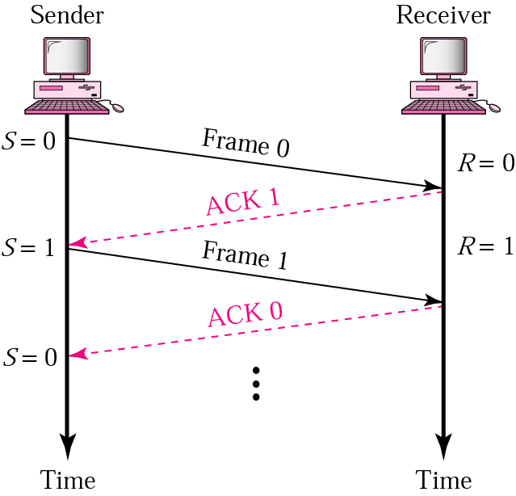
Stop-And-Wait ARQ
Normal Operation
Notes:
In the transmission of a frame, the sender sends frame 0 and waits to receive ACK 1. When ACK 1 is received, it sends frame 1 and then waits to receive ACK 0, and so on. The ACK must be received before the timer set for each frame expire.

Slide 41
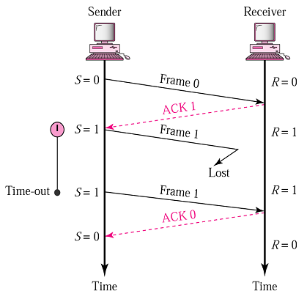
Stop-And-Wait ARQ
Lost or Damaged Frame
Notes:
When the receiver receives a damaged frame, it discards it, which essentially means the frame is lost.
The receiver remains silent about a lost frame and keeps its value of R unchanged.
After the timer at the sender site expires, another copy of the same frame is sent.

Slide 42
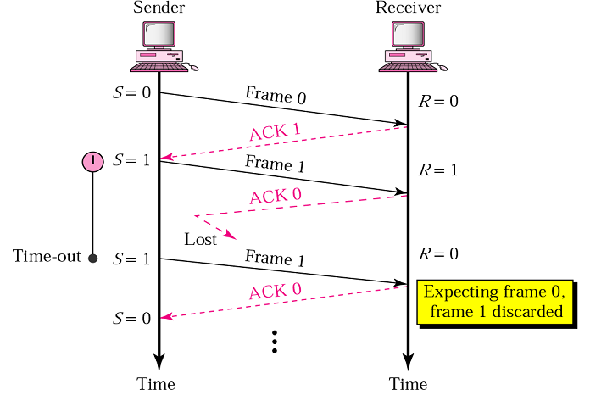
Stop-And-Wait ARQ
Lost Acknowledgement
Notes:
In Stop-and-Wait ARQ, numbering frames prevents the retaining of duplicate frames.

Slide 43
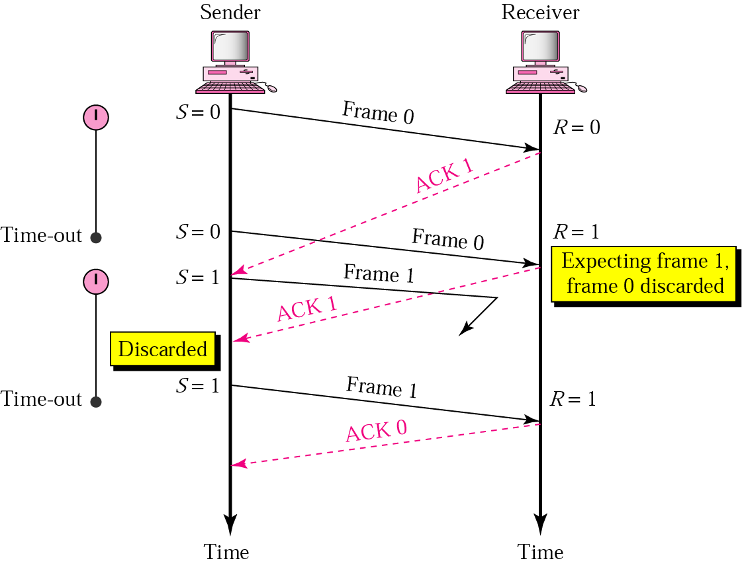
Stop-And-Wait ARQ
Delayed Acknowledgement
Notes:
Numbered acknowledgments are needed if an acknowledgment is delayed and the next frame is lost.

Slide 44
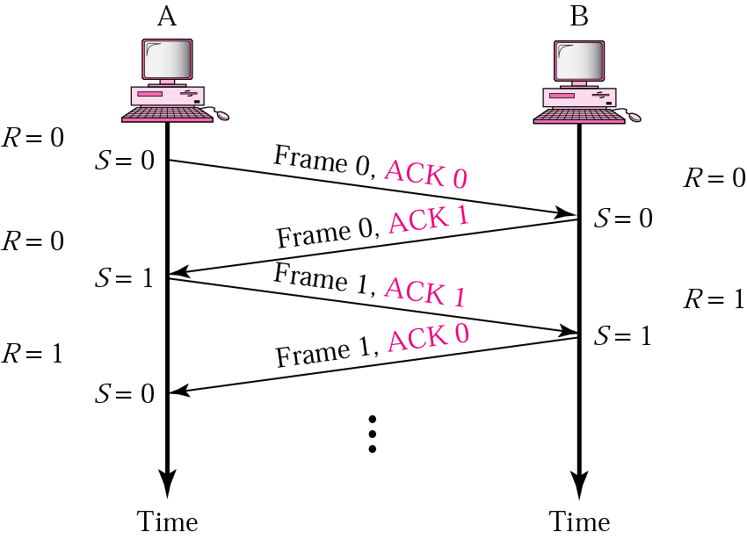
Piggy Backing
Bidirectional transmission
Full duplex transmission Half duplex transmission.
Piggybacking is a method to combine a data frame with an acknowledgement.
Piggybacking saves bandwidth.
Notes:
Bidirectional transmission is possible in stop-and-wait mechanism if the two parties have two separate channels for full duplex transmission or share the same channel for half duplex transmission.
Piggybacking saves bandwidth because the overhead from a data frame and an ACK frame can be combined into just one frame.

Slide 45
Example 11.3
Figure 11.11 shows an example of Stop-and-Wait ARQ. Frame 0 is sent and acknowledged. Frame 1 is lost and resent after the time-out. The resent frame 1 is acknowledged and the timer stops. Frame 0 is sent and acknowledged, but the acknowledgment is lost. The sender has no idea if the frame or the acknowledgment is lost, so after the time-out, it resends frame 0, which is acknowledged.
11.<number>

Slide 46

Figure 11.11 Flow diagram for Example 11.3
11.<number>

Slide 47
Stop and Wait - Pros and Cons
Simple
Inefficient

Slide 48
Go-Back-N ARQ

Slide 49
Go-Back-N ARQ: Send Window
Note
In the Go-Back-N Protocol, the sequence numbers are modulo 2^{m},
where m is the size of the sequence number field in bits.
The send window is an abstract concept defining an imaginary box of size 2^{m} − 1 with three variables: Sf, Sn, and S_{size}.
The send window can slide one
or more slots when a valid acknowledgment arrives.

Slide 50

Figure 11.12 Send window for Go-Back-N ARQ
11.<number>

Slide 51
Go-Back-N ARQ: Receive Window
Note
The receive window is an abstract concept defining an imaginary box of size 1 with one single variable R_{n}.
The window slides when a correct frame has arrived; sliding occurs one slot at a time.

Slide 52

Figure 11.13 Receive window for Go-Back-N ARQ
11.<number>

Slide 53
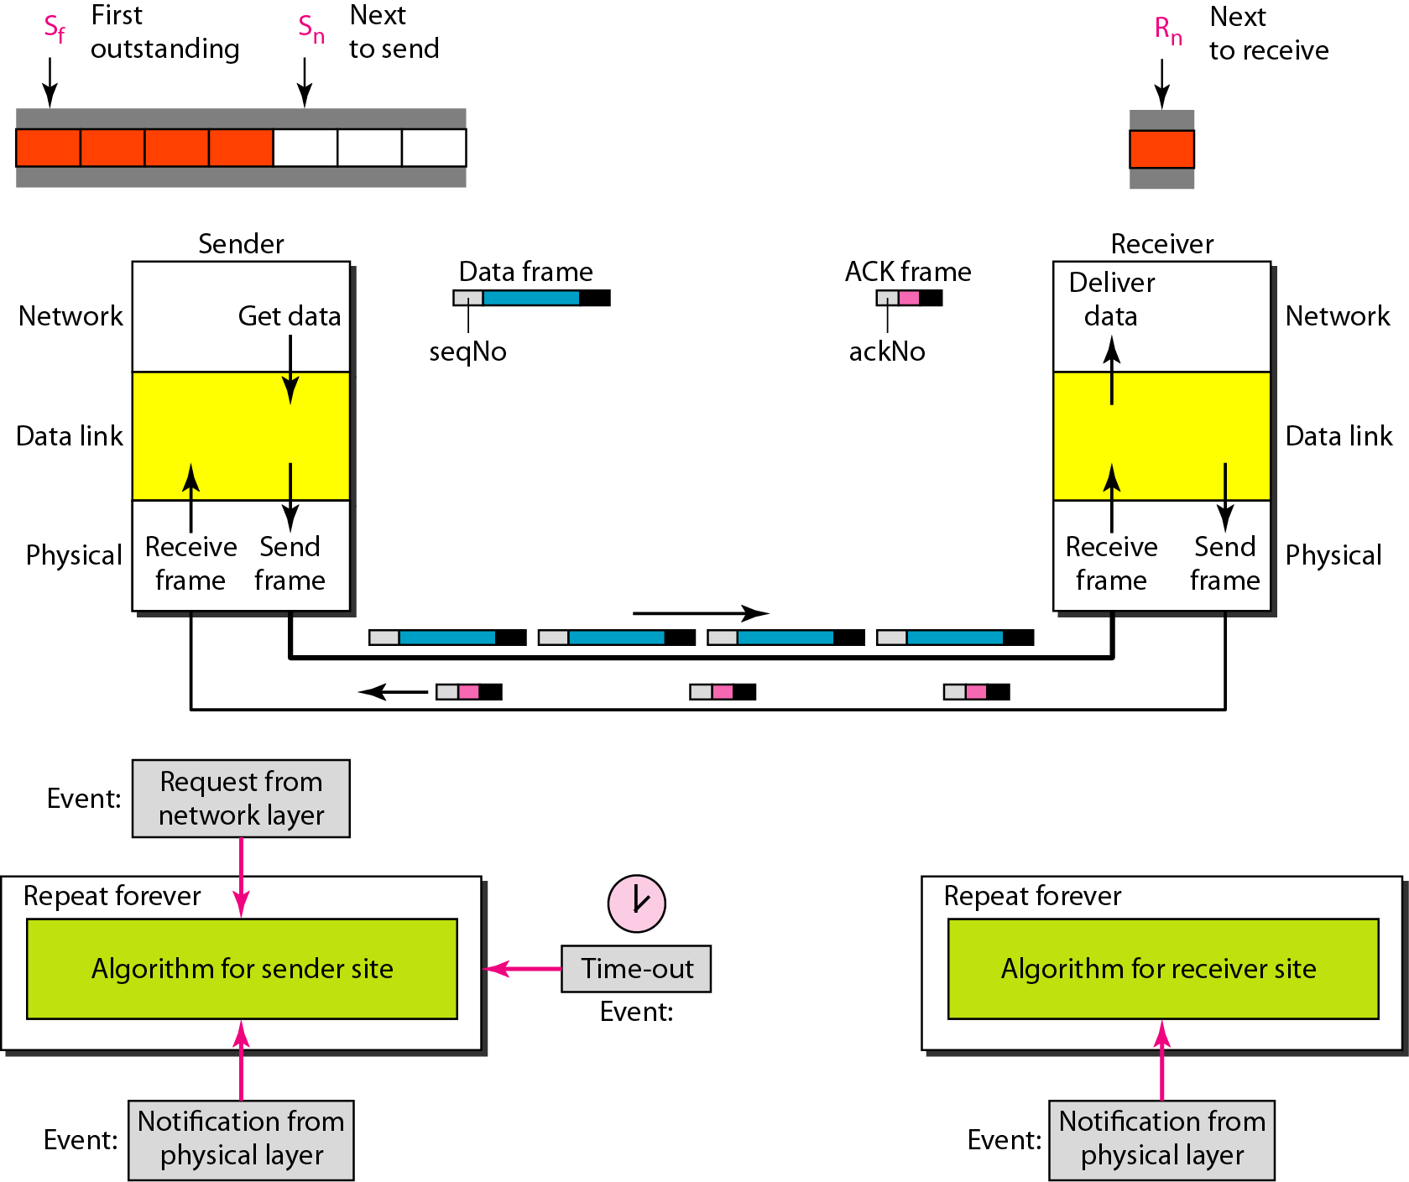
Figure 11.14 Design of Go-Back-N ARQ
11.<number>

Slide 54

Go-Back-N ARQ Operation

Slide 55

Go-Back-N ARQ Operation

Slide 56
Note
In Go-Back-N ARQ, the size of the send window must be less than 2^{m};
the size of the receiver window
is always 1.
11.<number>

Slide 57

Figure 11.15 Window size for Go-Back-N ARQ
11.<number>

Slide 58
Go-Back-N ARQ Efficiency
Go-Back-N is very inefficient for a noisy link (it has higher probability of damage).
Retransmits frames already received .
Inefficient use of bandwidth and slower transmission.

Slide 59
Selective Repeat ARQ

Slide 60
Selective Repeat ARQ
Selective Repeat ARQ does not resend N frames when just one frame is damaged; only the damaged frame is resent.
It is more efficient for noisy links, but the processing at the receiver is complex.
Selective Repeat ARQ defines a negative ACK (NAK) that reports the sequence number of a damaged frame before the timer expires.

Slide 61
Selective Repeat ARQ
In Go-back-N, the receiver is looking for one specific sequence number.
But in Selective Repeat ARQ the receiver is looking for a range of sequence number.

Slide 62

Figure 11.18 Send window for Selective Repeat ARQ
11.<number>

Slide 63

Figure 11.19 Receive window for Selective Repeat ARQ
11.<number>

Slide 64
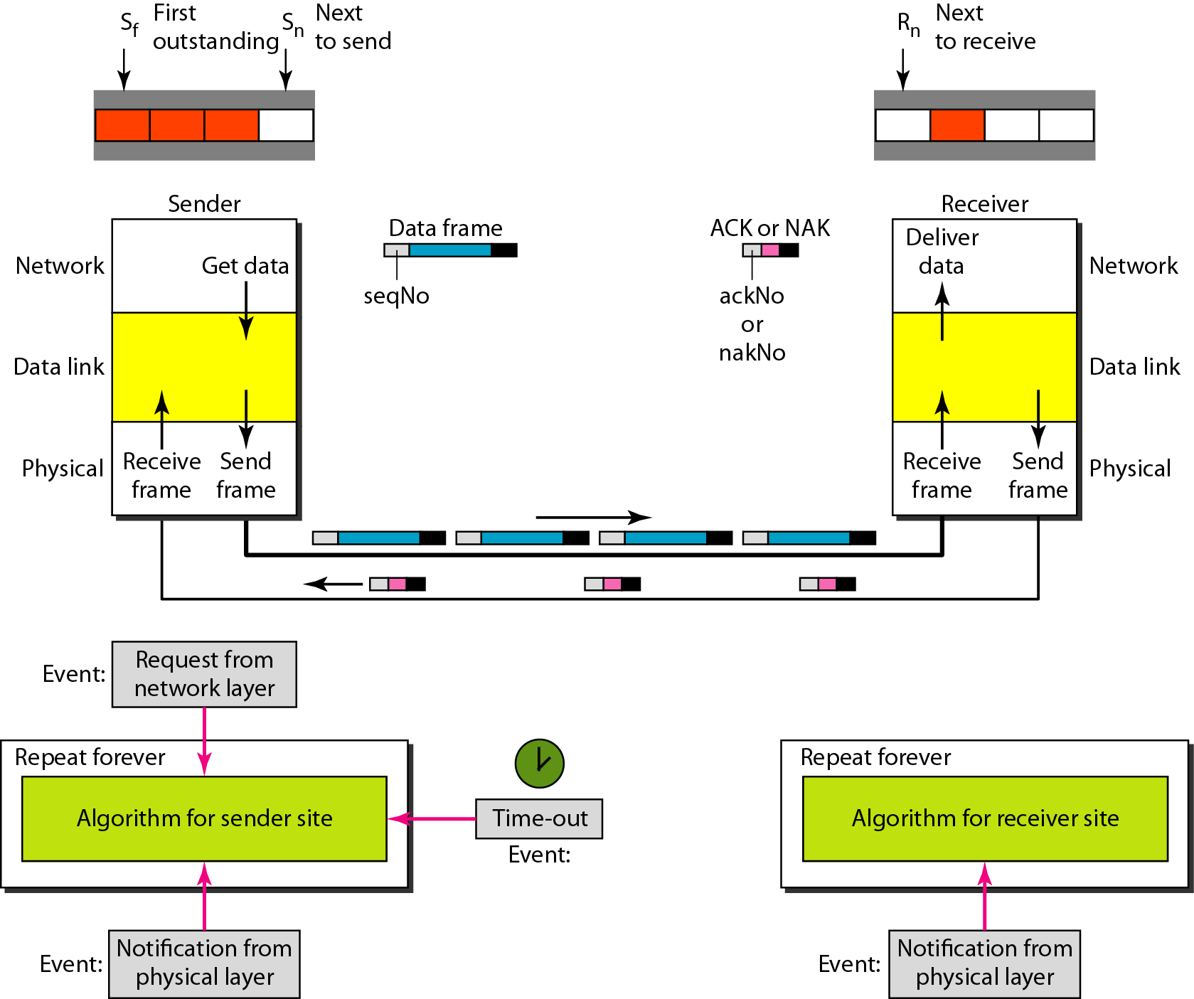
Figure 11.20 Design of Selective Repeat ARQ
11.<number>

Slide 65
Note
In Selective Repeat ARQ, the size of the sender and receiver window
must be at most one-half of 2^{m}.
11.<number>

Slide 66

Figure 11.21 Selective Repeat ARQ, window size
11.<number>

Slide 67

Flow diagram for Selective Repeat ARQ

Slide 68

Figure 11.22 Delivery of data in Selective Repeat ARQ
11.<number>

Slide 69
11-6 HDLC
High-level Data Link Control (HDLC) is a bit-oriented protocol for communication over point-to-point and multipoint links. It implements the ARQ mechanisms we discussed in this chapter.
Topics discussed in this section:
Configurations and Transfer Modes
Frames
Control Field
11.<number>

Slide 70
Modes of Communication
Mode: Is the relationship between two devices involved in an exchange
The mode describes who controls the link
Two Modes
  Normal response mode (NRM)
  Asynchronous balance mode (ABM)

Slide 71
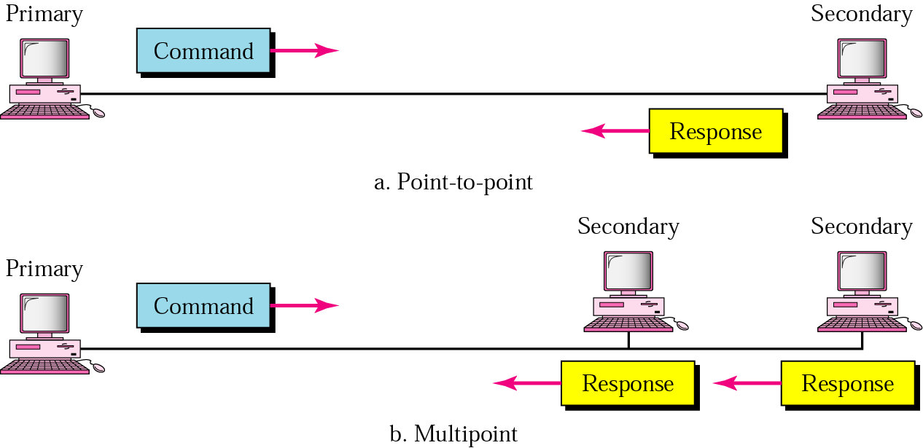
Normal Response Mode

Slide 72
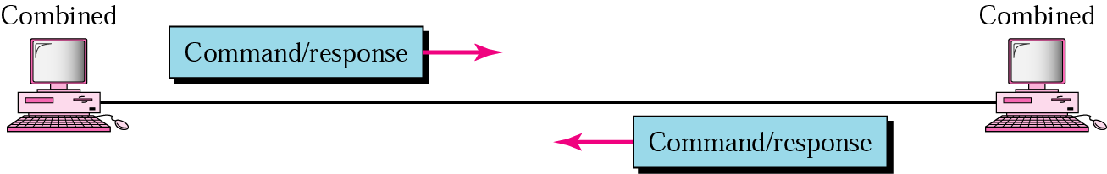
Asynchronous Balanced Mode

Slide 73
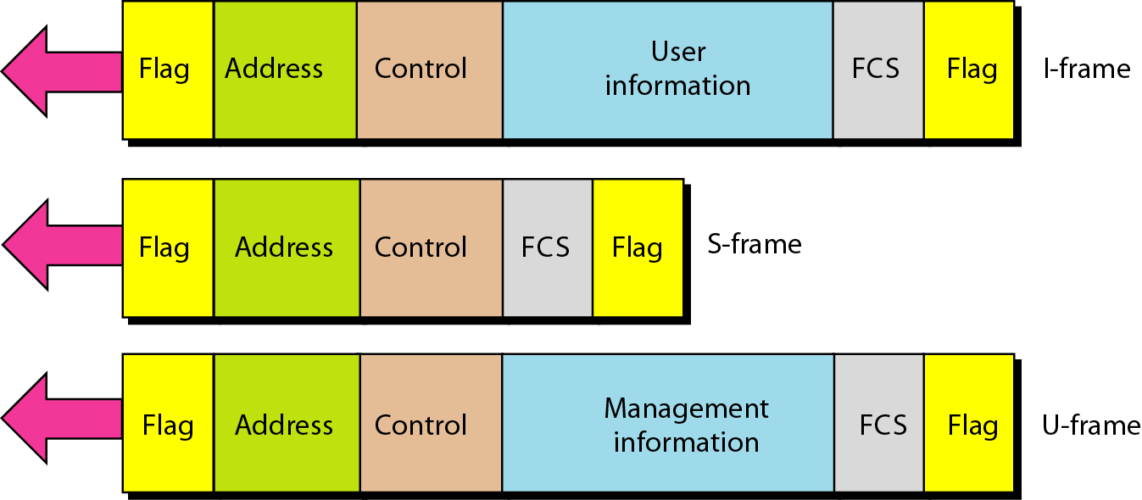
HDLC Frames
Three types of frames:
Notes:
Information frames (I-frames)
Used to transport user data and control information
Supervisory frames (S-frames)
Used only to transport control information
Primary data link layer flow and error controls
Unnumbered frames (U-frames)
Used for system management
Information carried by U-frames is intended for managing the link

Slide 74
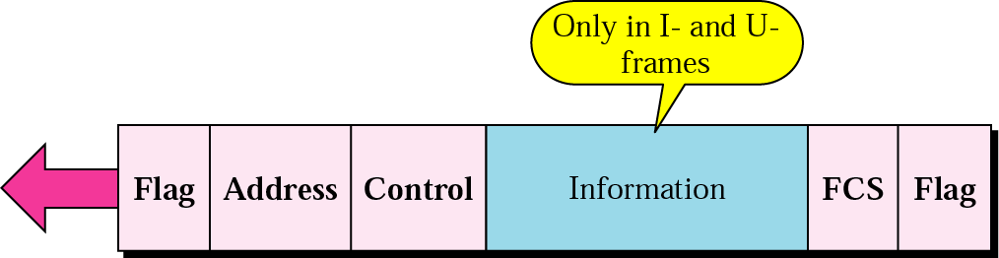
HDLC Frames with information

Slide 75
Flag field
Eight bit sequence
with a bit pattern 01111110
Identifies both the beginning
and end of a frame
Serves as a synchronization pattern for the receiver

Slide 76
Address field
Second field of an HDLC frame
Identifies the primary or secondary stations involvement in the frame transmission or reception.
Each station on the link has a unique address.

Slide 77
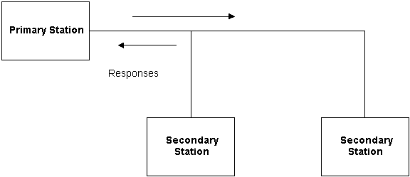
Address field
In an unbalanced configuration, the Address field in both commands and responses refers to the secondary station.
Commands

Slide 78
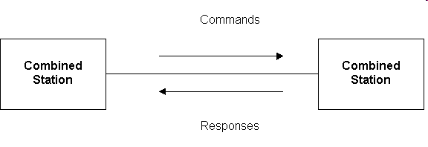
Address field
In a balanced configuration, the command frame contains the destination station address and the response frame has the sending station's address.

Slide 79
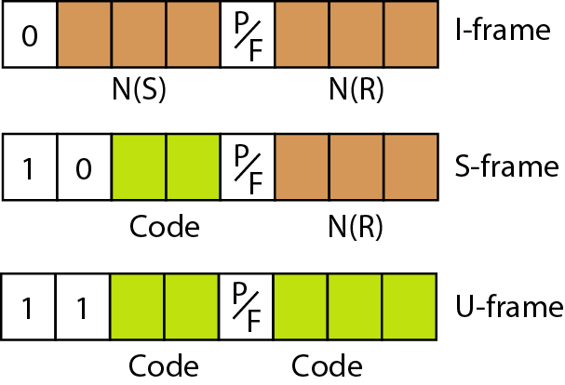
HDLC—Control field
I-frames and S-frames
  For Flow and Error Control
U-frames
  provide supplemental Link information.

Slide 80
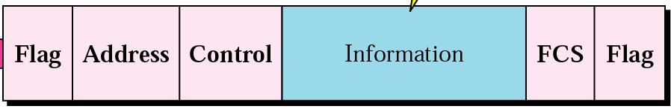
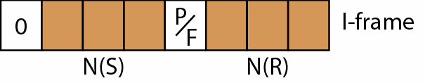
I-Frame
Frames containing data for transmission
Contains user data
Sequence no. of sent data (Seq no.)
Sequence no. of Received data (Ack no.)

Slide 81
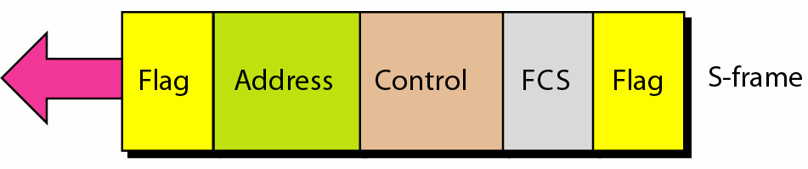
S-Frame
Used for acknowledgment, polling, temporary suspension of information transfer, or error recovery.
Frames with the S format control field cannot contain an information field.

Slide 82
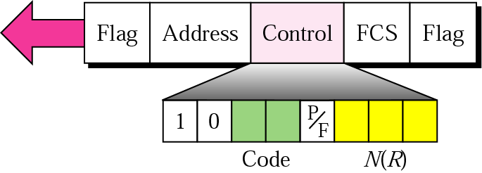
S-frame control field in HDLC
Sequence no. of Received data (Ack no.)
Code |  | Command
00 | RR | Receive ready
01 | REJ | Reject
10 | RNR | Receive not ready
11 | SREJ | Selective-reject

Slide 83
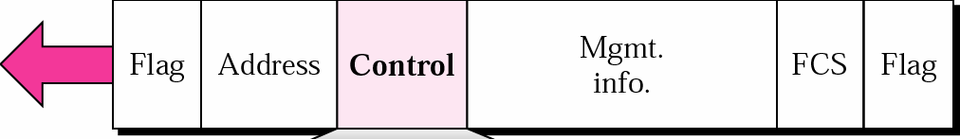
Un-numbered frame
Used for link management
  For example they are used to set up the logical link between the primary station and a secondary station
  To inform the secondary station about the mode of operation which is used.)
  Or to terminate the link

Slide 84
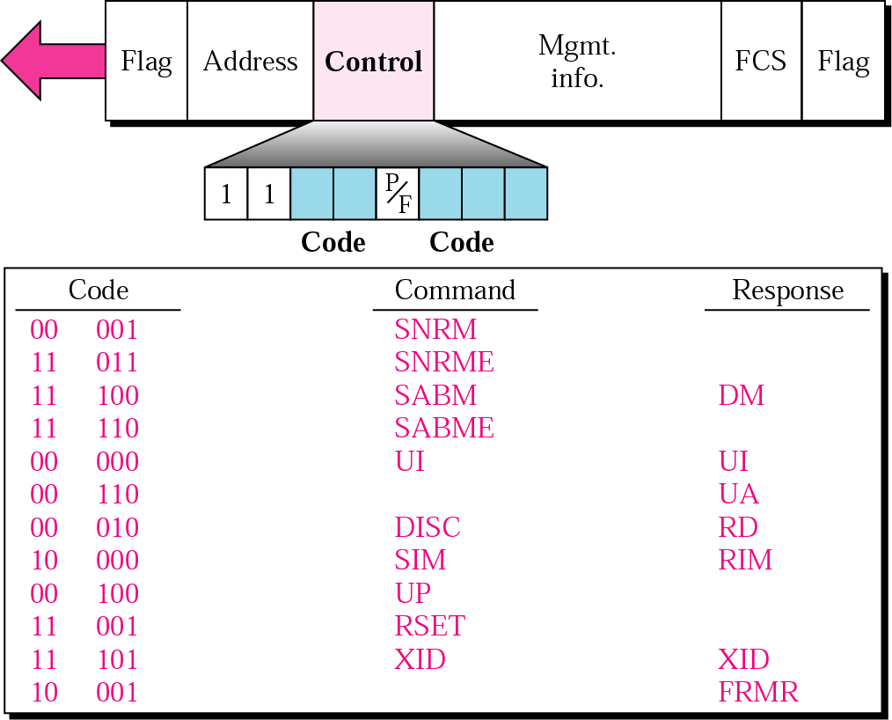
U-frame control field in HDLC

Slide 85
HDLC—Control field-- (P/F) bit
It can only be recognized when it is set to 1. If it is set to 0, it is ignored.
The poll/final bit is used to provide dialogue between the primary station and secondary station.
The P bit signifies a poll. Poll—frame sent by a primary station to a secondary
  Address field contains the address of the receiver
Final—frame sent by a secondary station to a primary
  Address field contains the address of the sender

Slide 86
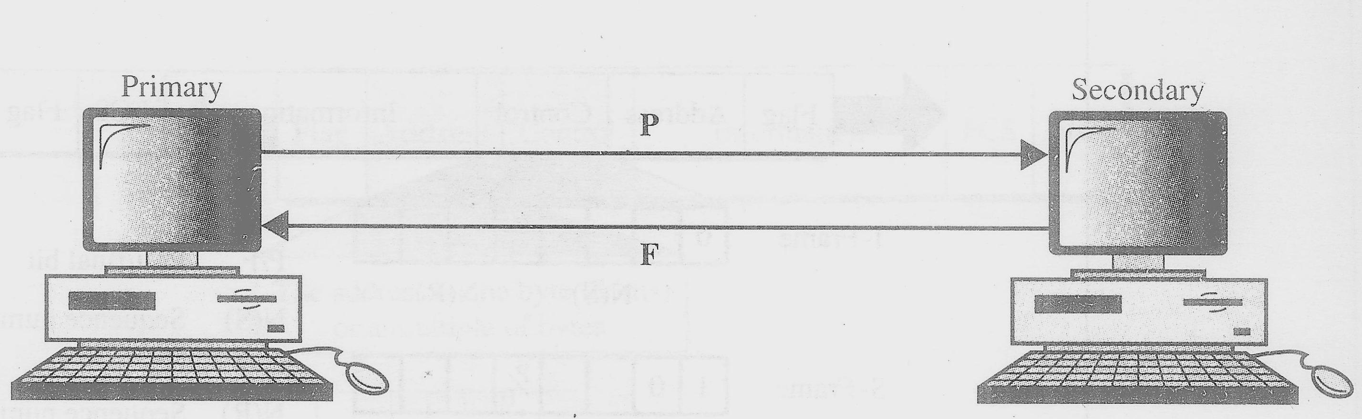
Poll/final field in HDLC

Slide 87
Frame check sequence(FCS)field
This field contains a 16 bit, or 32 bit cyclic redundancy check (CRC).
CRC is a error detection method.

Slide 88
HDLC Operation
Exchange of information, supervisory and unnumbered frames
Three phases
  Initialization
  Data transfer
  Disconnect

Slide 89
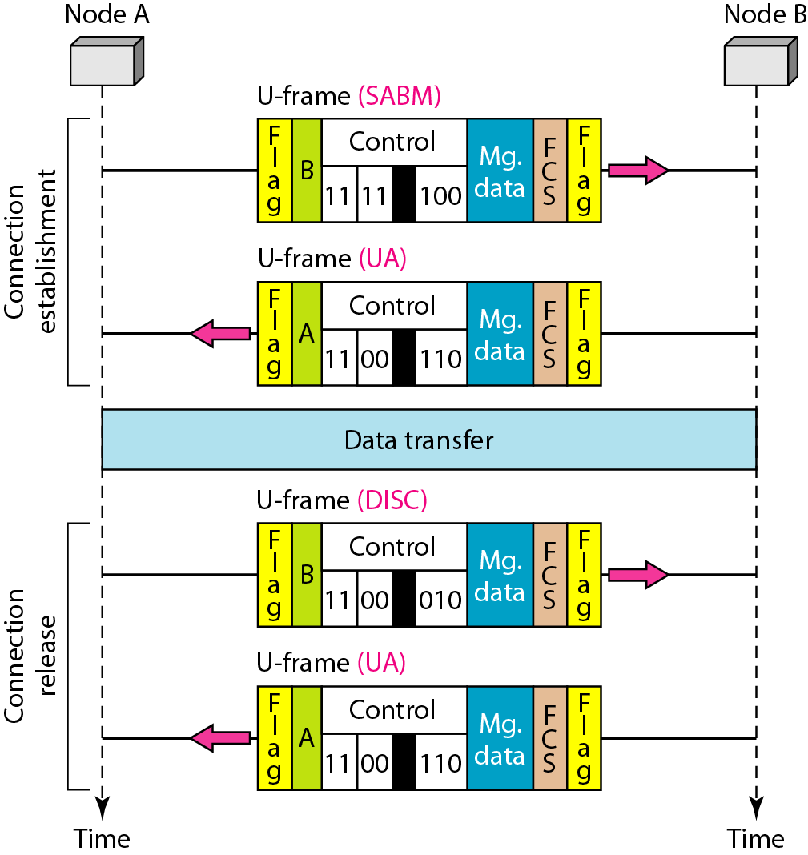
Example of connection and disconnection

Slide 90
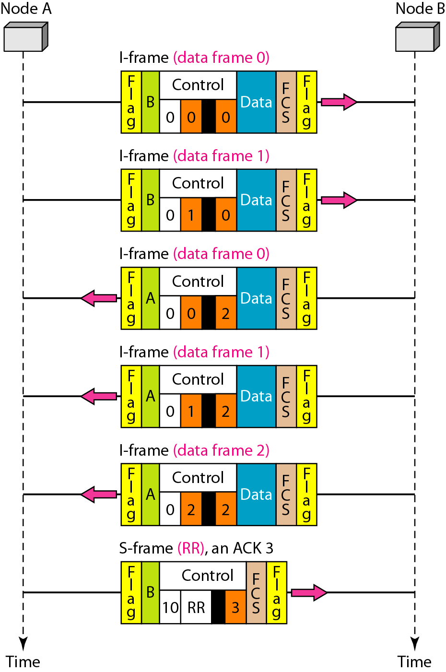
Example of piggybacking without error

Slide 91
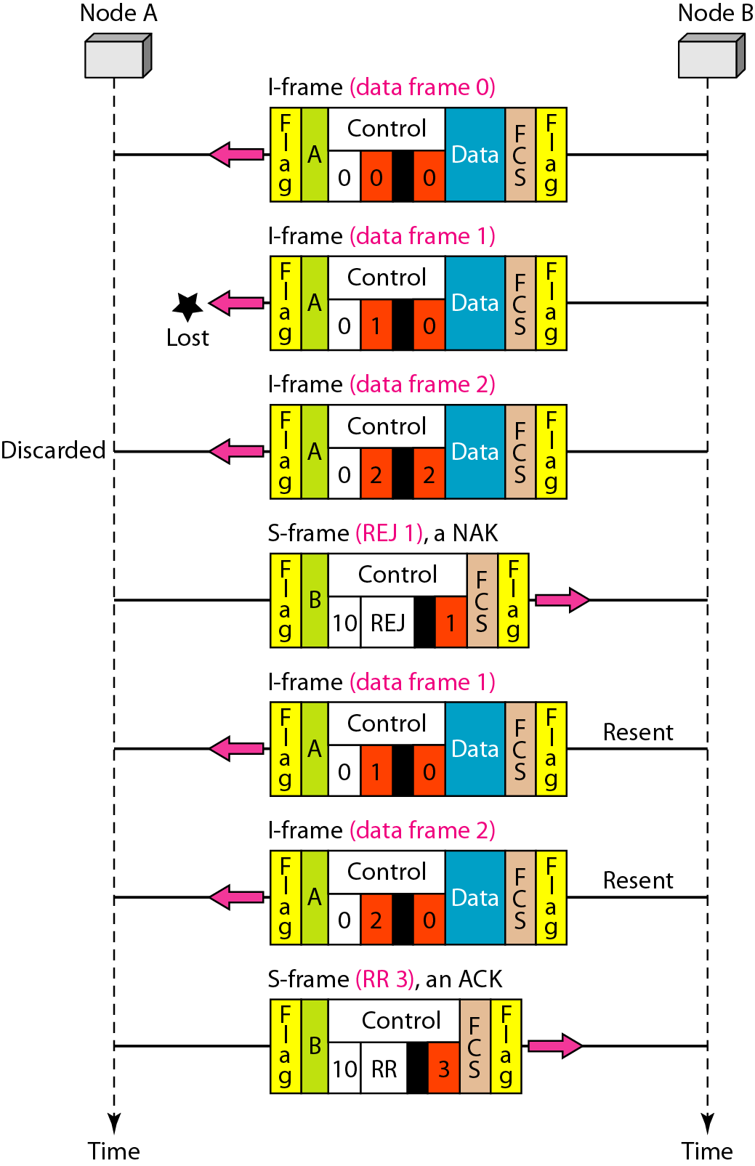
Example of piggybacking with error

Slide 92
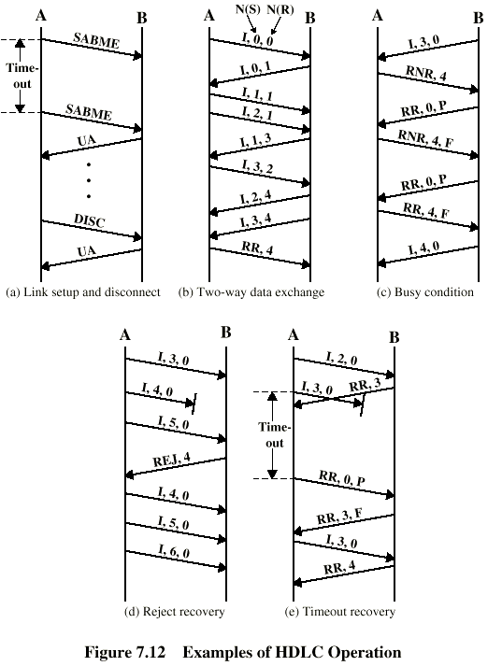
Examples of Operation (1)

Slide 93
Examples of Operation (2)

Slide 94
THE END

